Slide 1

AI ELECTRONICS BLUEPRINT GENERATOR
Generate Electronic Circuit Designs, Component Analysis, and 2D Schematics using Generative AI
Team By George Micheal Eskander
Mark Medhat Michael
Instructor By Eng Nourhan Moumoud
Notes:
Welcome everyone. Today we're presenting our graduation project — an AI-powered system that revolutionizes how electronics engineers design circuits. Instead of spending hours on manual schematic design, our tool generates professional circuit blueprints from simple natural language descriptions.

Slide 2
The Problem
Why Electronics Design Remains a Barrier
Steep Learning Curve
Time-Consuming Research
Beginners struggle with electronics fundamentals and lack guided learning paths for practical circuit design.
Selecting components takes extensive research time across multiple datasheets and vendor catalogs.
Complex Documentation
Error-Prone Process
Reading datasheets is complex and requires deep technical expertise to interpret specifications correctly.
Designing schematics manually is slow and tedious. Small mistakes lead to costly hardware failures.
KEY CHALLENGES
TIME CONSUMING
COMPLEX
ERROR-PRONE
REQUIRES EXPERIENCE
02 / 09
Notes:
Electronics design has a steep learning curve. Beginners spend weeks learning just to build a simple voltage regulator. Even experienced engineers waste hours cross-referencing datasheets. One wrong resistor value can destroy an entire prototype. The process is fundamentally broken — it's time-consuming, complex, and error-prone.

Slide 3
Our Solution
An Intelligent Electronics Assistant Powered by AI
EXAMPLE INPUT
User Idea — Natural language description
"I need a 12V to 5V voltage regulator using LM7805 with an LED indicator."
AI Analysis — NLP + Prompt Engineering
Component Selection — Intelligent matching
Connection Instructions — Step-by-step wiring
2D Circuit Generation — Schemdraw engine
Final Blueprint — Professional schematic
KEY TECHNOLOGIES
NLP
PROMPT ENGINEERING
LLM REASONING
AUTO SCHEMATIC GENERATION
03 / 09
Notes:
Our solution is elegantly simple. The user describes what they need in plain English — for example, "I need a 12V to 5V voltage regulator using LM7805 with an LED indicator." The AI understands the request, selects the right components, explains how to connect them, and generates a professional schematic automatically. No manual drawing. No datasheet hunting. Just describe and receive.

Slide 4
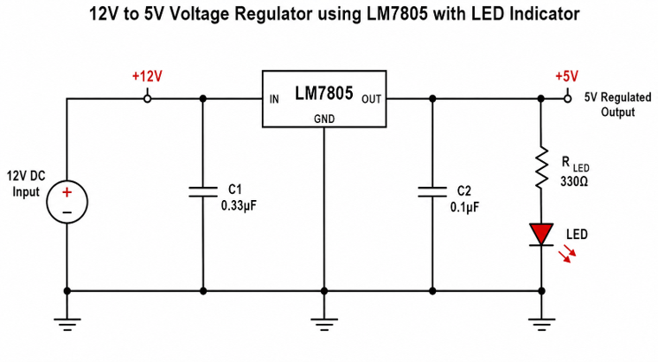
System Architecture
How the Components Work Together
User
Streamlit Interface — Web UI
Prompt Engineering — Structured request
Gemini API — Google Generative AI
Python Processing — Code generation
AI Response — JSON-structured output
Schemdraw Engine — 2D rendering
Generated Circuit — SVG/PNG output
DATA FLOW
User Input → Structured Prompt → AI Analysis → Component Data → Schemdraw Code → Rendered Diagram → Display
04 / 09
Notes:
Here's our system architecture. The user interacts through a Streamlit web interface. Their natural language input is processed by our prompt engineering layer, which structures the request for the Gemini API. The AI returns component data and Schemdraw code. Python processes this, the Schemdraw engine renders the diagram, and the final schematic appears seamlessly in the user's browser.

Slide 5
Technology Stack
Built with Modern, Reliable Tools
Python
Streamlit
Gemini API
Core language and application logic
Interactive web interface framework
Generative AI reasoning engine
Google Generative AI
Schemdraw
SVG
Advanced LLM reasoning capabilities
Circuit diagram generation engine
Scalable vector graphics output
TikZ / LaTeX
JSON
Markdown
LaTeX diagram export format
Structured data exchange format
Rich text formatting and docs
Prompt Engineering
GitHub
VS Code
AI request optimization layer
Version control and collaboration
Development environment
05 / 09
Notes:
Our tech stack is entirely modern and open-source friendly. Python and Streamlit handle the frontend and backend. Google's Gemini API provides the AI reasoning power. Schemdraw generates the actual circuit diagrams. We support multiple output formats — SVG, TikZ, even Netlist. Everything is version-controlled on GitHub and developed in VS Code.

Slide 6
Application Workflow
From Natural Language to Professional Schematic
1
User enters circuit description
5
AI generates output
Natural language input via Streamlit interface
Components, values, wiring instructions, and Schemdraw code
2
Streamlit receives input
6
Python executes code
Web interface captures and validates the request
Automated rendering pipeline processes the AI output
3
Prompt Engineering structures request
7
Schemdraw renders schematic
Request is optimized and formatted for the AI model
Professional 2D circuit diagram is generated
4
Gemini analyzes circuit
8
User receives complete output
AI reasoning performs component selection and analysis
Explanation, component list, and circuit diagram delivered
USER RECEIVES
Detailed Explanation
Step-by-step circuit analysis
Complete Component List
Values, specs, and datasheets
Circuit Diagram
Professional 2D schematic
EXAMPLE INPUT
"I need a 12V to 5V voltage regulator using LM7805 with an LED indicator."
06 / 09
Notes:
Let me walk you through the actual workflow. The user types their circuit idea into the Streamlit interface. Our prompt engineering layer structures this for the Gemini API. The AI analyzes the request, determines all needed components — resistors, capacitors, the LM7805 regulator, LED — calculates values, explains connections, and generates Schemdraw code. Python runs this code, Schemdraw renders the diagram, and the user gets a complete explanation, component list, and professional schematic in seconds.

Slide 7
Live Demo
See It In Action
STREAMLIT INTERFACE
GENERATED SCHEMATIC
AI Circuit Generator
Describe your circuit:
"I need a 12V to 5V voltage regulator using LM7805 with an LED indicator"
GENERATE
✓ Circuit analyzed
✓ Components selected
✓ Schematic generated
GENERATED COMPONENT LIST
Component | Value | Purpose
U1 | LM7805 | 5V Voltage Regulator
C1 | 0.33µF | Input bypass capacitor
C2 | 0.1µF | Output stability capacitor
R1 | 220Ω | LED current limiting resistor
D1 | 5mm Red LED | Power indicator
07 / 09
Notes:
Here's what the user sees. On the left, a clean Streamlit interface — just a text box and a generate button. The user types their circuit description. On the right, within seconds, they receive a professional schematic like this LM7805 regulator with LED indicator. Below, a complete component list with values and purposes. No manual drawing. No calculator needed. The AI handles everything.

Slide 8
Future Roadmap
What's Next for AI Electronics Design
PHASE 1 — NEAR TERM
PHASE 2 — MEDIUM
PHASE 3 — ADVANCED
PHASE 4 — VISION
0-6 months
6-12 months
12-18 months
18+ months
Export to Proteus
PCB Auto-Design
Voice Commands
ESP32 & IoT
Export to Altium
3D Visualization
Circuit Optimization
Fault Detection
BOM Cost Estimation
Simulation Engine
Arduino Code Gen
Auto-Debugging
"From idea to manufactured PCB — fully AI-driven"
08 / 09
Notes:
This is just the beginning. Our roadmap extends from schematic generation to full PCB auto-design. We'll add Proteus and Altium export for professional workflows. A simulation engine will let users test circuits virtually. Voice commands will make it even more accessible. Eventually, we envision AI-driven fault detection, automatic Arduino code generation, and IoT integration. The goal is end-to-end electronics design automation.

Slide 9
Conclusion
AI Simplifies Design
Reduces Engineering Time
Helps Beginners Learn
Natural language replaces complex CAD tools and manual processes
From hours of manual work to seconds of automated generation
Interactive, immediate feedback accelerates the learning curve
Improves Accuracy
Automates Documentation
Professional Schematics
AI-validated component selection eliminates costly mistakes
Auto-generated explanations, component lists, and schematics
Publication-ready diagrams generated instantly in multiple formats
Notes:
To conclude: Our AI Electronics Blueprint Generator transforms how we approach circuit design. It makes electronics accessible to beginners while dramatically accelerating professional workflows. The AI handles the complexity — component selection, value calculation, wiring instructions, and schematic generation — so engineers can focus on innovation. Remember: Design Electronics with the Power of Artificial Intelligence. Thank you, and I'm happy to take any questions.

Slide 10


Instructor By Eng Nourhan Moumoud

